Slide 1
Coding goals:
Understand how to talk to a computer by typing commands.
Use coding to solve problems with variables.
Use coding to create visuals with fractions.

Slide 2
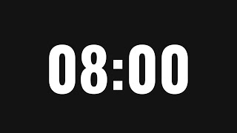
Introduction to Variables and Comments
Does the output change if you change a comment?
Can you change the code so that it will print 5?

Slide 3
Strings
Print all the names of the people in your group!

Slide 4
Variables for linear equations
See Python lesson on this topic.

Slide 5
Concatenating Strings = combining strings together
Print a sentence for each person!

Slide 6
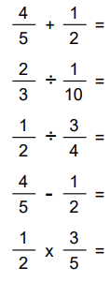
Object oriented programming using fractions
Assign your variable to be a fraction.
Solve fraction math problems like these:

Slide 7
Complex Fraction Operations
Can you make an equation where the answer comes out to be 20?
1?
0?
1,000,000

Slide 8
Shout outs!
Highlight students who worked well together.
Celebrate students' successes and identify challenges.

Slide 9
Lesson 2a
Recall how we used pictures to represent fractions in day 0. Here, we let the computer draw them.

Slide 10
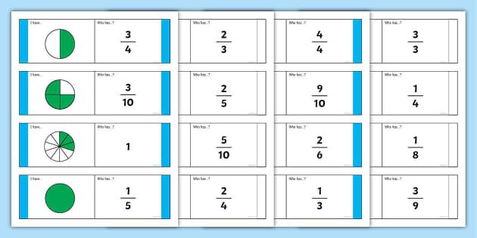
Representing fractions using pictures
Use the coding to show different fractions.
What is the biggest denominator you can make?
Can you make a fraction greater than 1?

Slide 11
Multiple fractions using pictures
Use the coding to show 4 equivalent fractions.
Use the coding to show 3 fractions in order from least to greatest.
Use the coding to show skip counting by ¼’s to get to 2 wholes.

Slide 12
Shout outs!
Highlight students who worked well together.
Celebrate students' successes and identify challenges.

